Slide 1
RNA modification
Dr. Kuntala S. Bordoloi
Assistant Professor
Department of Botany
Manga;dai College

Slide 3
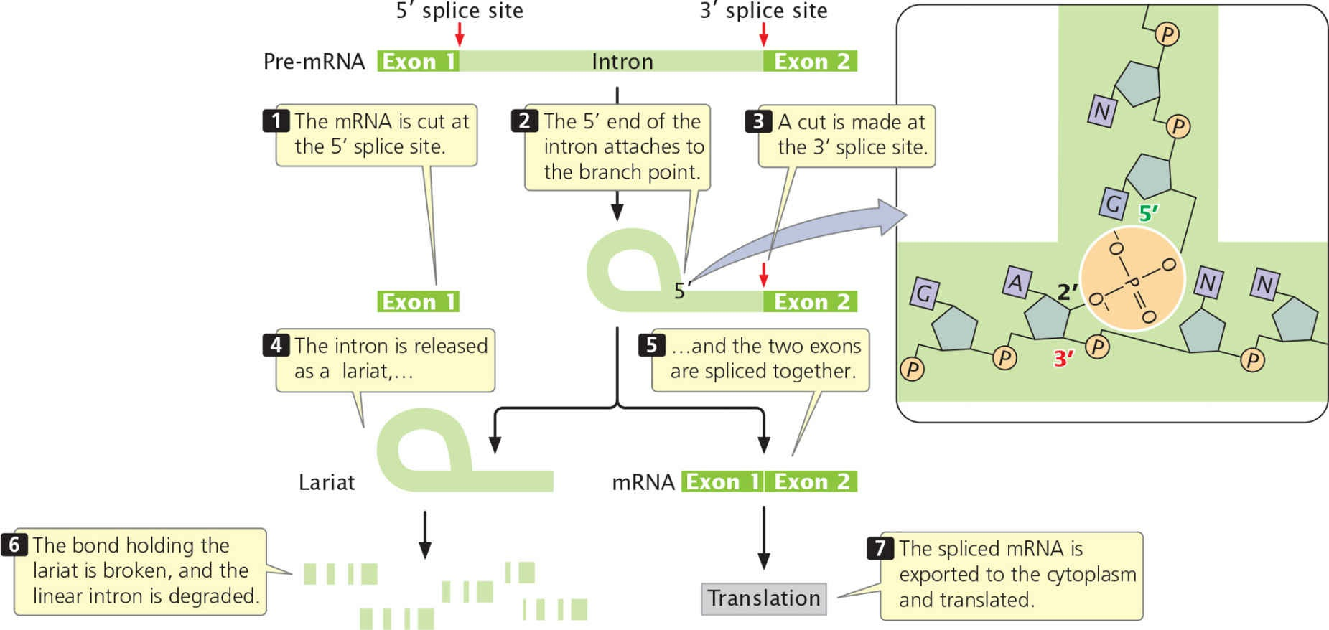
Fig. The splicing of nuclear introns requires a two-step process.

Slide 4
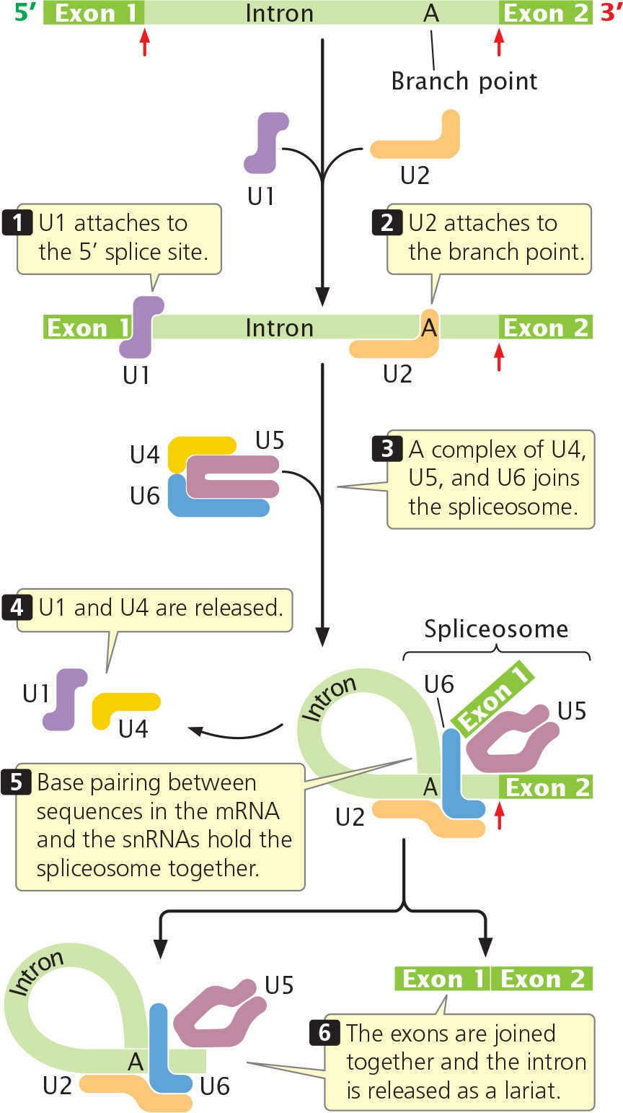
Fig. RNA splicing takes place within the spliceosome. The spliceosome assembles sequentially.

Slide 5
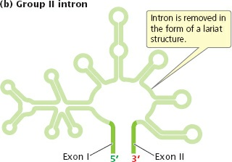
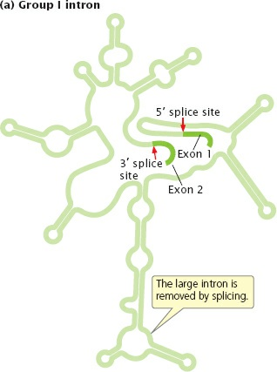
Fig. Group I and group II introns fold into characteristic secondary structures.

Slide 6
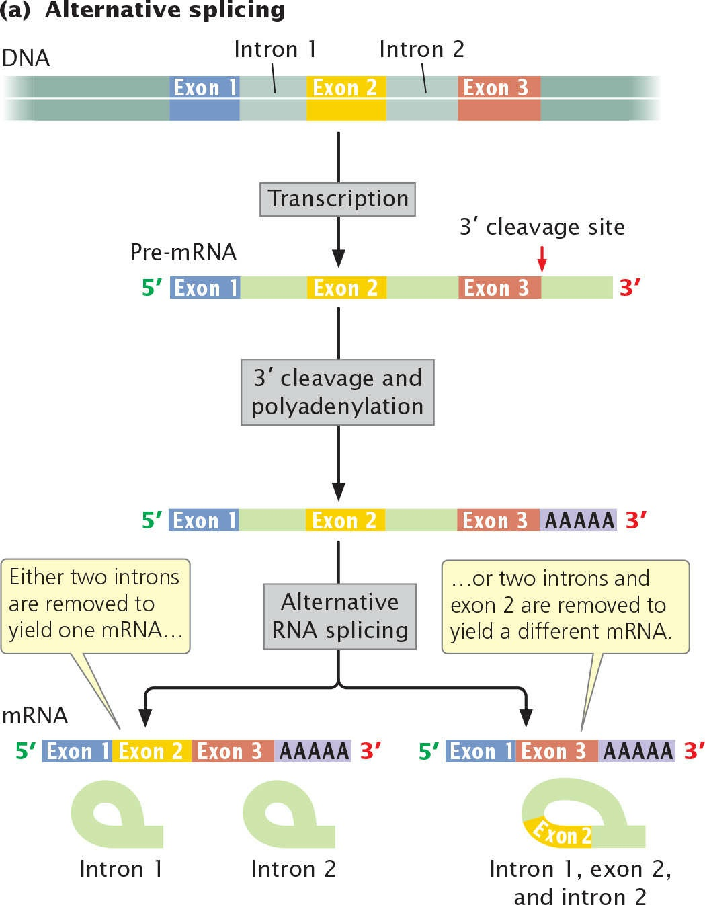
Fig. With alternative splicing, pre-mRNA can be spliced in different ways to produce different mRNAs.

Slide 7
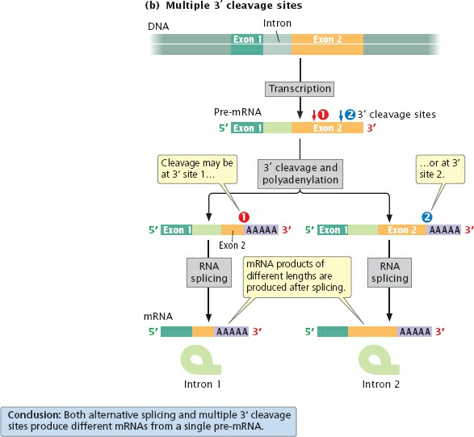
Fig. With multiple 3′ cleavage sites, there are two or more potential sites for cleavage and polyadenylation; use of the different sites produces mRNAs of different lengths.

Slide 8
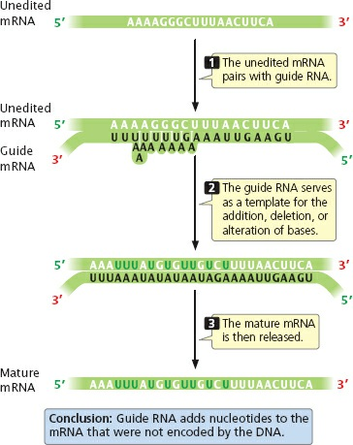
Fig. The gRNA has sequences that are partly complementary to those of the unedited mRNA and pairs with it. After this pairing, the mRNA undergoes cleavage and new nucleotides are added, with sequences in the gRNA serving as a template. The ends of the mRNA are then rejoined.

Slide 9
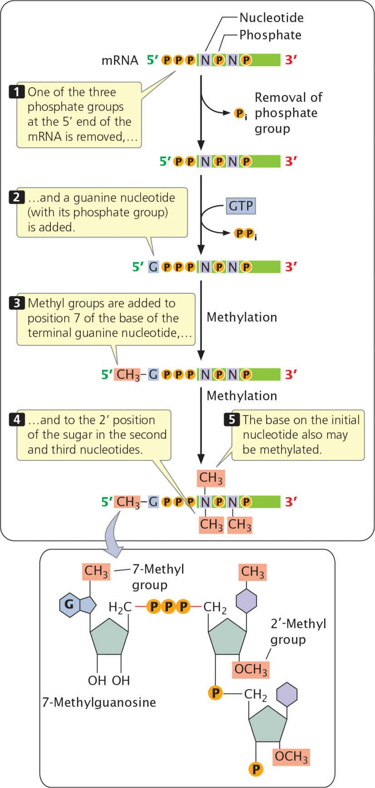
Fig. The cap consists of 7-methylguanosine attached to the pre-mRNA by a unique 5′–5′ bond (shown in detail in the bottom box).

Slide 10
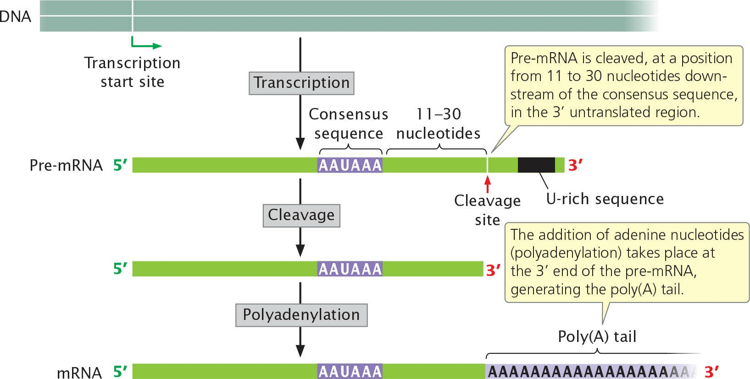
Fig. Most eukaryotic mRNAs have a 3′ poly(A) tail

